Slide 1
Inpatient Pediatric Rehabilitation
Prior Authorization implementation 1/1/2024
Provider Education 2023

Slide 2
Inpatient Pediatric Rehabilitation
Pediatric inpatient rehabilitation services are designed to provide comprehensive, individually tailored care plans to meet the physical, developmental, social, educational and psychological needs to the patient and the patient’s family.
Pediatric inpatient rehabilitation will provide intensive rehabilitative therapy in a resource-intensive inpatient hospital environment for members who, due to the complexity of their nursing, medical and rehab needs, require and can reasonably be expected to benefit from an inpatient stay and interdisciplinary team approach.
This benefit covers members under age 21.

Slide 3
Criteria
InterQual® Criteria will be used in the review process. Criteria includes, but is not limited to:
Comorbidity that falls at minimum, but not limited to one of the following conditions
Arthritis
Advanced/Severe Osteoarthritis
Brain injury
Burns
Cardiac conditions
Congenital deformity
General debility
Fractures
Multiple traumas
Neurological disorders
Oncology
Respiratory insufficiency
Spinal Cord
Stroke
Traumatic amputation

Slide 4
Criteria continued
Must have a significant decline of functional impairment of ambulation and other activities of daily living immediately proceeding the inpatient rehab admission
Must have the potential to improve with more intensive rehab that is unique to the inpatient rehabilitation and can not be performed in another care setting
Must have reasonable expectations of active participation
Please refer to the Hospital Services Provider manual for a full detailed description of criteria.

Slide 5
Prior Authorization Requests
Authorization requests should be submitted prior to the transfer to inpatient rehabilitation.
Authorization requests may be submitted online at https://portal.kepro.com or by fax using the Inpatient Prior Authorization Request form.

Slide 6
Inpatient Notes
Authorizations will be approved for a 2-week period.
Required documentation for initial reviews will include preadmission screening tool, documentation of reasonable expectation that at the time of admission, the patient’s condition is such that the patient can reasonably be expected to actively participate in, and benefit from, intensive therapy.
Required documentation for continued stay reviews will include an industry standard pediatric inpatient rehabilitation patient assessment instrument, such as WEEFIM.

Slide 7
Authorization Types
Prior Authorization
Should always be submitted on or before the service begins.
**highly recommend submitting at least 3-5 days before expected transfer
Retrospective Authorization “Retro”
Needed when services were performed before the member was eligible for Medicaid and the member has since been granted retrospective eligibility covering the date of service.
A Retro case is NOT one that is submitted late for any reason other than eligibility.
Untimely requests will be administratively denied.
Providers must identify a request as RETRO on the fax request form or by request type in Atrezzo.

Slide 8
Processing Timelines
Acentra Health completes requests for services expeditiously and within contractual timeframes. The review completion timeframe is measured from the date Acentra Health receives a request.
New Request/Admission review – 5 business days
Retrospective Reviews – 5 business days

Slide 9
Review Process
Administrative Requirements
Nurse Review
Physician Review
InterQual® or State defined criteria applied
May pend for additional clinical information
Approve if criteria met
Refer to physician reviewer if documentation does not support medical necessity
The medical director, or another qualified physician reviewer will review the case against InterQual® or State defined criteria and national standards to provide a decision.
The physician or qualified practitioner may approve or deny the review.
Member eligibility verified
Provider eligibility verified
Medicaid Guidelines applied

Slide 10
Pended Reviews
A review may be pended for one of the following reasons:
Missing required information such as plan of care or provider number
Additional information or clarification is needed before a decision can be made
Notifications are sent via fax or web portal.
A provider has 2 business days to respond to the additional information request
If the case contains no clinical information, the case will be administratively denied.
If the case has insufficient clinical information and there is no response to the pended, the case will move to the physician reviewer for a determination.
If a review is administratively denied, the provider may submit a new request once they have all the necessary information.

Slide 11
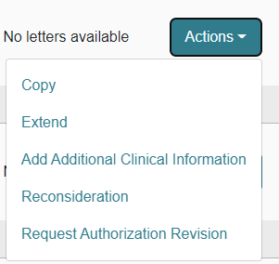
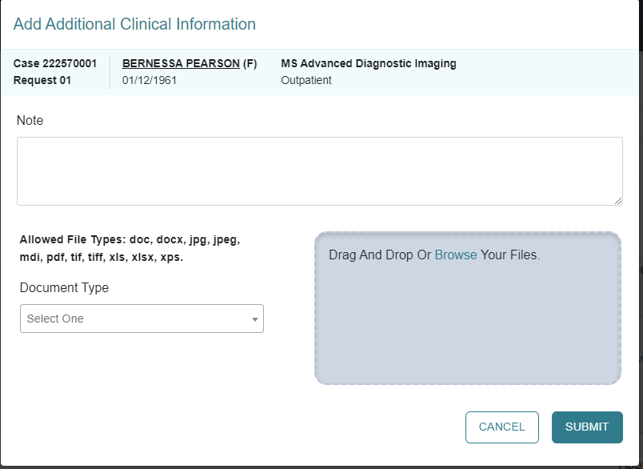
Responding to Pended Reviews
If you submitted the request online thru the Portal:
Log into the Portal and open the pended case.
ACTION TAB – additional Clinical Information.
Upload the requested documents or type the information in the note section.

Slide 12
Denials and Reconsiderations
Administrative Denial
When any portion of the review is denied because it does not comply with Medicaid regulations
Example: untimely, insufficient information
Clinical Denial
Occurs when any portion of the requested service is denied by a physician reviewer due to medical necessity
Does not meet state Medicaid criteria with information submitted or does not meet other national evidence-based criteria
Reconsideration
May only be requested for clinically denied cases
Provider may submit a new case for the service if an administrative denial is received. This does not apply to those cases that were denied for untimely submission.
Not used for Administrative Denials

Slide 13
Reconsiderations
May be submitted within 60 days of the clinical denial date
This is your opportunity to provide more detailed clinicals.
May be submitted:
Via phone (will still require additional information to be faxed)
Fax
Web portal *preferred
A clinical reviewer will review any additional information submitted. If unable to meet InterQual® or State approved criteria, it will be referred to the physician reviewer.
A physician reviewer – a different physician from the one who originally reviewed the case - will look at the case and any new information submitted to support the reconsideration.
The physician reviewer may
Uphold original decision (no change made).
Overturn the original decision (approve the case).
If original decision is upheld, provider may appeal the decision to SCDHHS.
Notes:
Need to clarify how many days they have to submit a reconsideration…

Slide 14
Appeals
If a reconsideration is upheld, an appeal may be requested. Specific instructions will be included in the reconsideration determination letter.
SCDHHS will review the provider’s request and conduct a Fair hearing.
Members may request an appeal within 30 calendar days from the reconsideration determination notice:
online at www.scdhhs.gov/appeals,
Fax 803 255 8206
Email appeals@scdhhs.gov
Mail Office of Appeals and Hearings
PO BOX 8206
Columbia, SC 29202
Notes:
Verify this information

Slide 15
Resources and Education
Hospital Services Provider Manual
Provider Training Resources | SCDHHS
SC Acentra Health website
Acentra Health Customer Service
1-855-326-5219
scproviderissues@kepro.com generic questions please, do not include PHI

